Slide 1



Hostel Management system
Presented by: Hackers
Mostak Ahmed
ID:cse06307481
Nahid Hasan Munna
ID:cse06307468
Abu Adnan Joy
ID:cse06307482

Slide 2
INTRODUCTION
What is Hostel
Types of Hostel
Managing Hostel Of this project

Slide 3
Motivation for this project
1. vast opportunities.
2. Solving real life problem
3. Time consuming.
4. Easy to access.

Slide 4
Features
1. Member add
2. Member Delete
3. View Information
4. Create DMP Form
5. Add meal
6. Add shopping cost
7. Add other Cost
8. View meal rate

Slide 5
Project Feasibilities
Technical feasibilities
Economic Feasibility
Operational Feasibility

Slide 6
Technical Feasibilities
1. The technical feasibility of the proposed system is related to the technology used in the system.
2. All Platform

Slide 7
Economic Feasibility
1. Economic analysis is the most commonly used method for evaluating the effectiveness methods.
2. Commonly knows as cost / benefit analysis C#,HTML, and SQL databases are easily available on the Internet.

Slide 8
Operational Feasibility
1. The project is developed in such a way that it becomes very easy to execute with any computer knowledge.
2. This software is very user-friendly and does not require a technical person to manage it, so the project is even possible.

Slide 9
Project scheduling
1. Analysis
2. Planning
3. Construction
4. Deployment

Slide 10
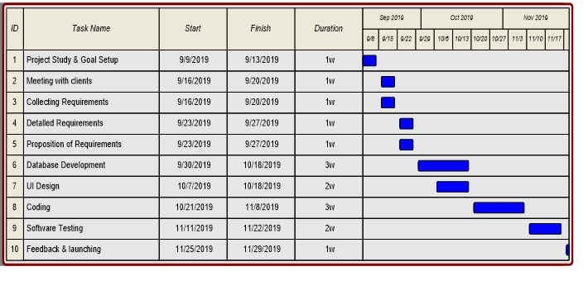
Gantt Chart

Slide 11
END
Thanks to All

